Slide 1
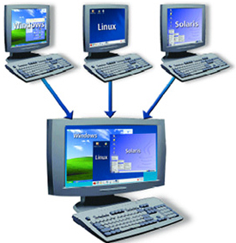
Containers
Docente: Dott. Daniele Gobbo Modulo 1

Slide 2
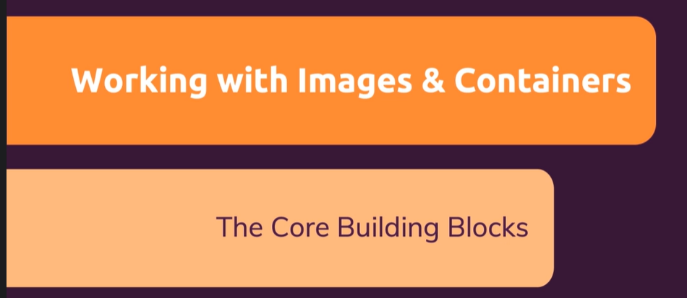



Module Introduction

Slide 3
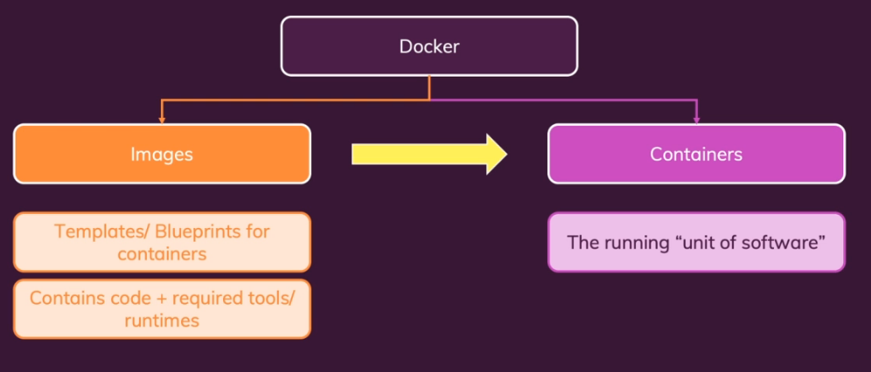

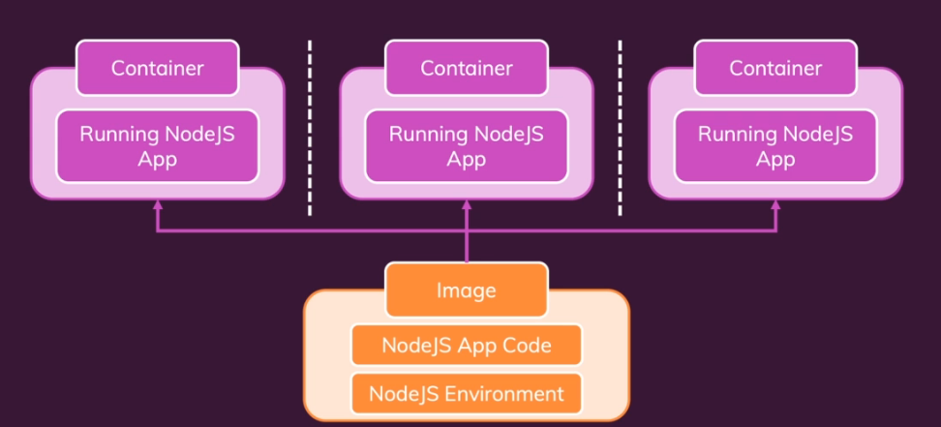
Images & Containers: What and Why?

Slide 4
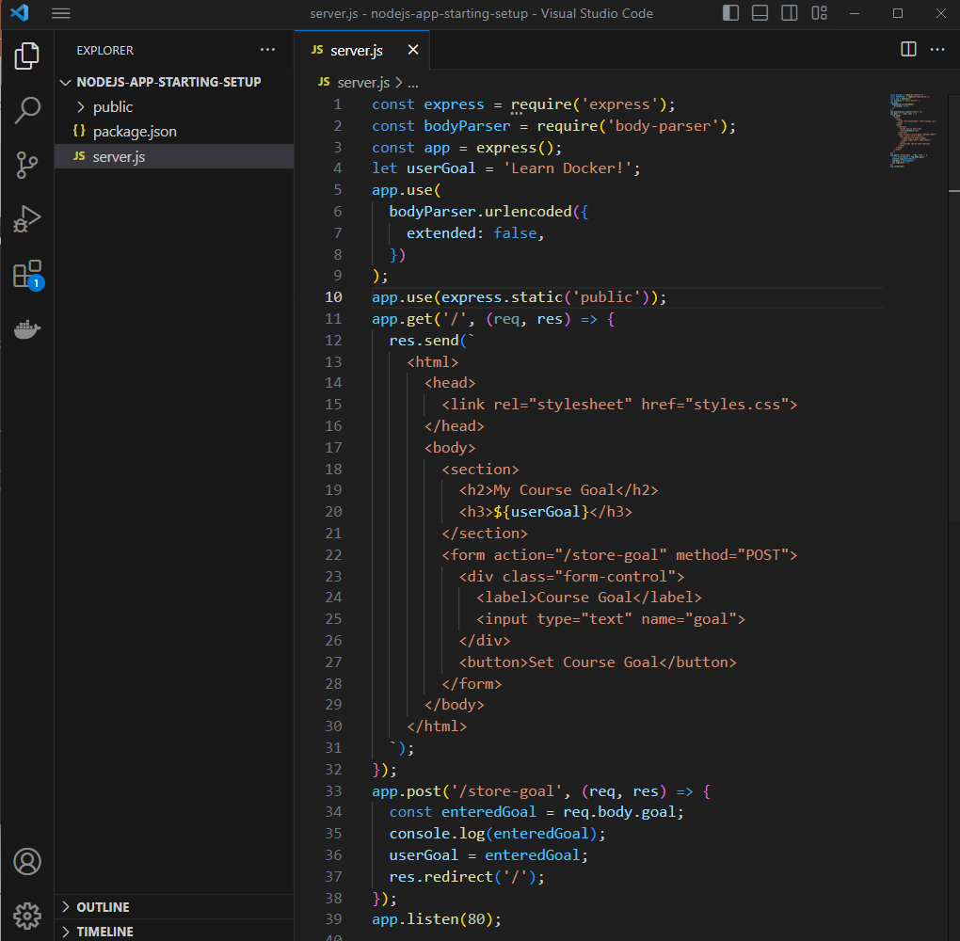
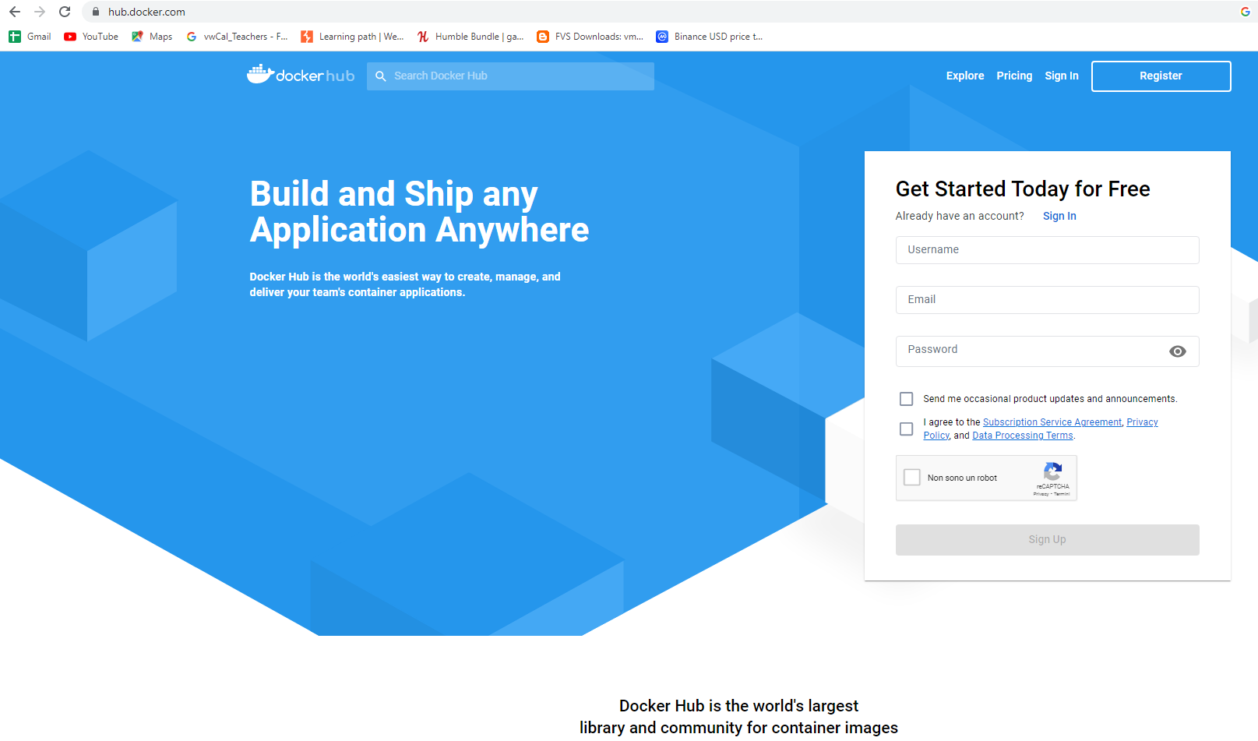
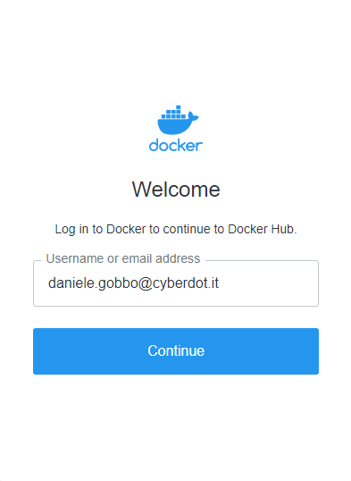
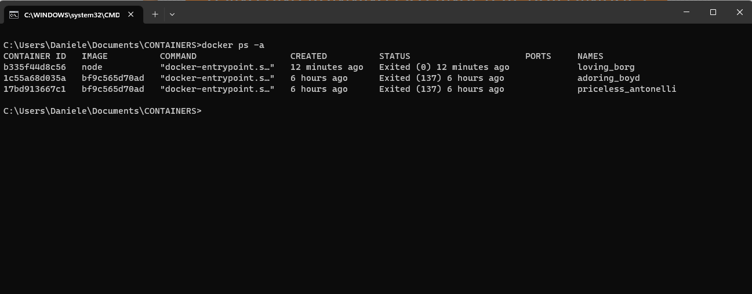
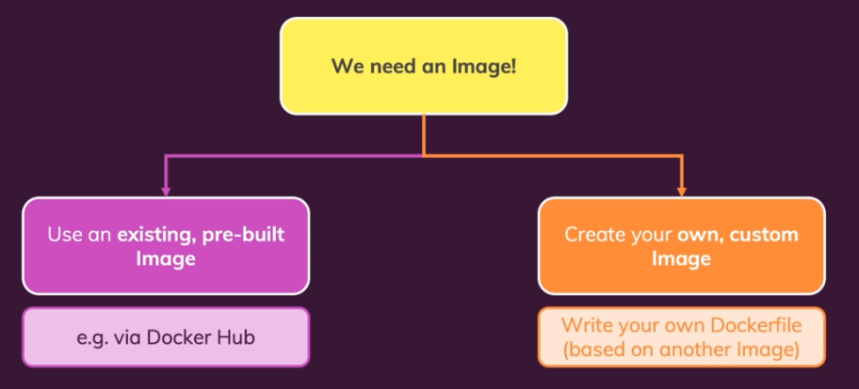
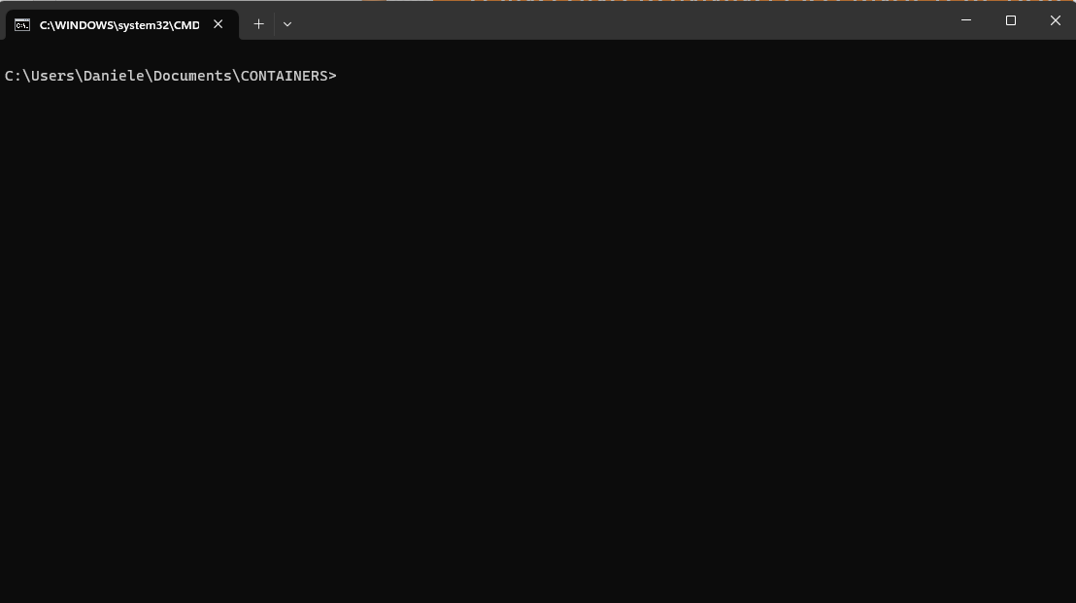
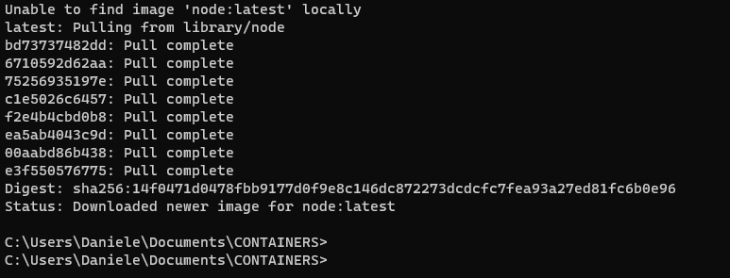
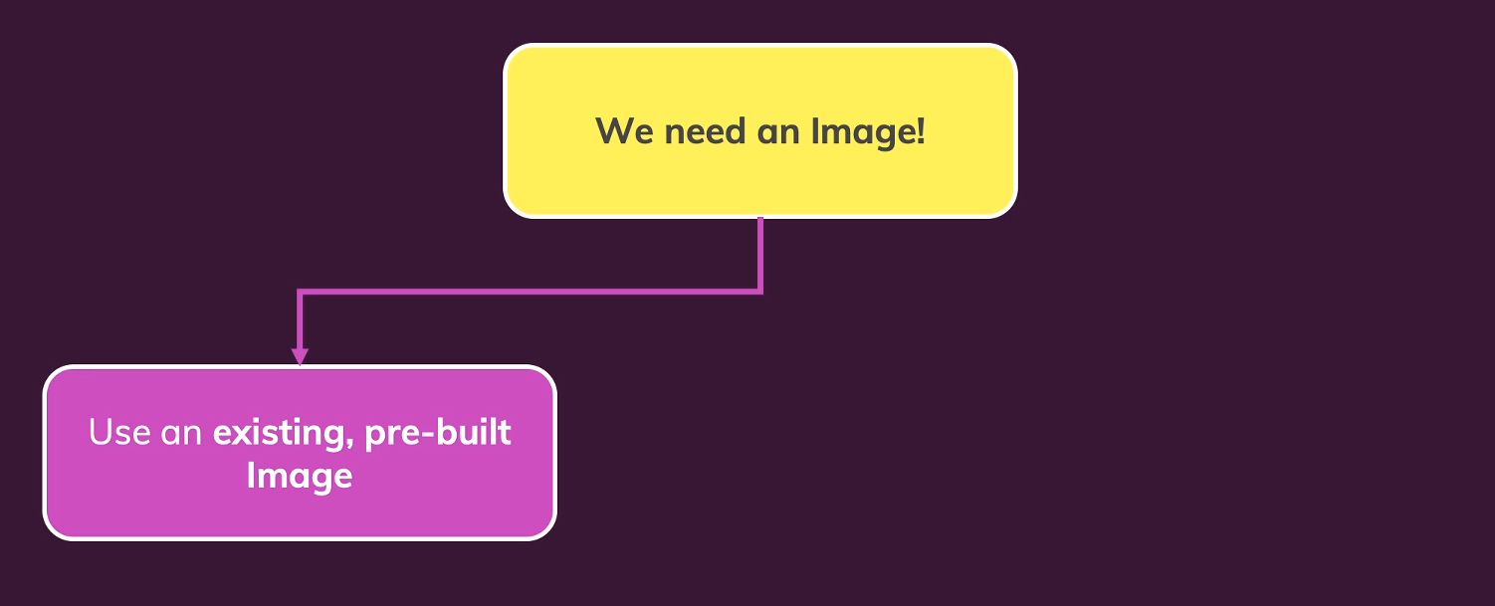
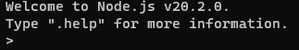
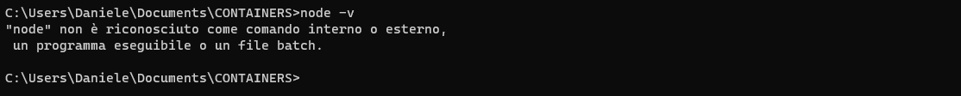
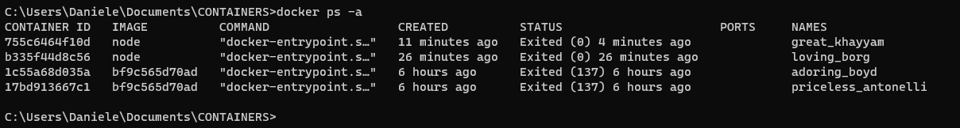

USING AND RUNNING EXTERNAL (PRE BUILT)IMAGES
Containers are based on images.
There will be two ways
of creating or getting an image
so that we then can run a container
Contain our main node application code. This code start a web server with nodejs listening on port 80
and we handle incoming requests to two URLs
to our domain /.
How can we now build our own image that contains this application and that then also utilizes the node Docker hub image to run that code?
This downloads the latest node image from Docker Hub and once it downloaded it locally into our machine, it will run this image as a container.
Did we now create a container based on an image?
Well, yes, we did.
Node is of course just a software you could say
and indeed we can execute node to get an interactive shell where we can insert command.
But by default, and that's important, a container is isolated from the surrounding environment and just because there might be some interactive shell running inside of a container does not mean that this shell is exposed to us as a user.
this node image which you find on Docker Hub, can be used by anyone and it is distributed and created and maintained by the official node team.
Please create on documents folder a new folder “Container”, open cmd and navigate to this folder
Now in the vast majority of use cases,
you don't just want to download and run an imagethat gives you an interactive shell.
We could build up on the node image
to then execute certain node JS,PHP,PHYTON code with that image.
Typically you would pull into your official base image and then add your code on top of that
to execute your code with that image.
Please open project n°2 with Visual Studio Code
Node is not running on our machine here
and I can prove this……Please note that here we're interacting with node 20.2.0 (inside container).
Press CTRL+C twice for shutdown and exit from container….

Slide 5
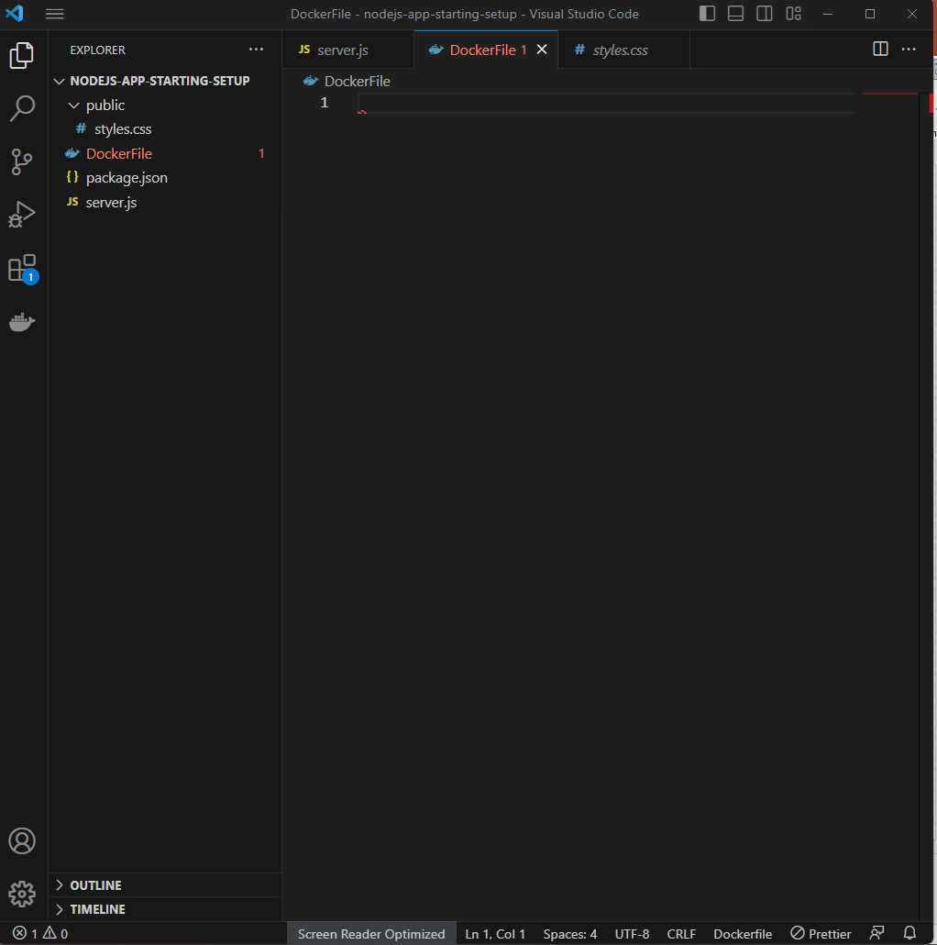
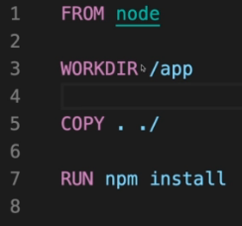
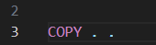
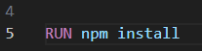
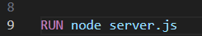
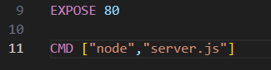
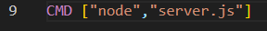
All these here are instructions to Docker
for setting up the image
Keep in mind the image should be the template for the container.
The image is not what you run in the end, you run a container based on an image
And therefore with this command, we would try to start the server in the image, so in the template, but that's not what we want.
We want to install all the dependencies there, yes,
we want to have all the code in there, yes, but we only wanna start a server
if we start a container based on an image.
Also so that if we start multiple containers on one and the same image, we also start multiple node servers. So therefore here we have another instruction
The difference to run is that this will now not be executed when the image is created, but when a container is started based on the image
Docker container is isolated.
It's isolated from our local environment.
And as a result, it also has its own internal network.
And when we listen to port 80 in the node application inside of our container,
the container does not expose that port to our local machine.
To expose port 80 to our local enviromente, we need add another instruction to docker file.
it is a good idea to not use
the root folder, the root entry in your Docker container but some sub folder which is totally up to you.
You can name it however you want.
And here I will name this \app
next step:
we wanna tell Docker
which files that live here on our local machine
should go into the image.
And for Docker get to COPY command.
First dot would tell Docker
this first dot would tell Docker that all the folders, sub folders and files here in this project should be copied into image
Second dot is the path inside of the image where those files should be stored.
Every image and for also every container created based on an image, has its own internal file system
which is totally detached
from your file system on your machine.
next step, we need to run NPM install
For node applications, we had to run NPM install
in order to install all the dependencies of our node application.
BUILDING OUR OWN IMAGE WITH A DOCKERFILE
Now we want start our server
And this image now exists on Docker hub.
And actually since we already executed a container based
on this image at the moment it also exists on our local machine because when we run a container
based on this Docker hub image for the first time,
this image was downloaded and cached locally.
So now this is basically both a local and a Docker hub image.
Please create a new file «dockerfile».
This file will contain the instructions for Docker
that we wanna execute when we build our own image.
So it contains the setup instructions for our own image.
And typically here you start with the FROM instruction
Now with that, we finished our Dockerfile
with all the setup instructions for a Docker image.
Now let's see how we can utilize this custom image, build it and how we can run it.

Slide 6
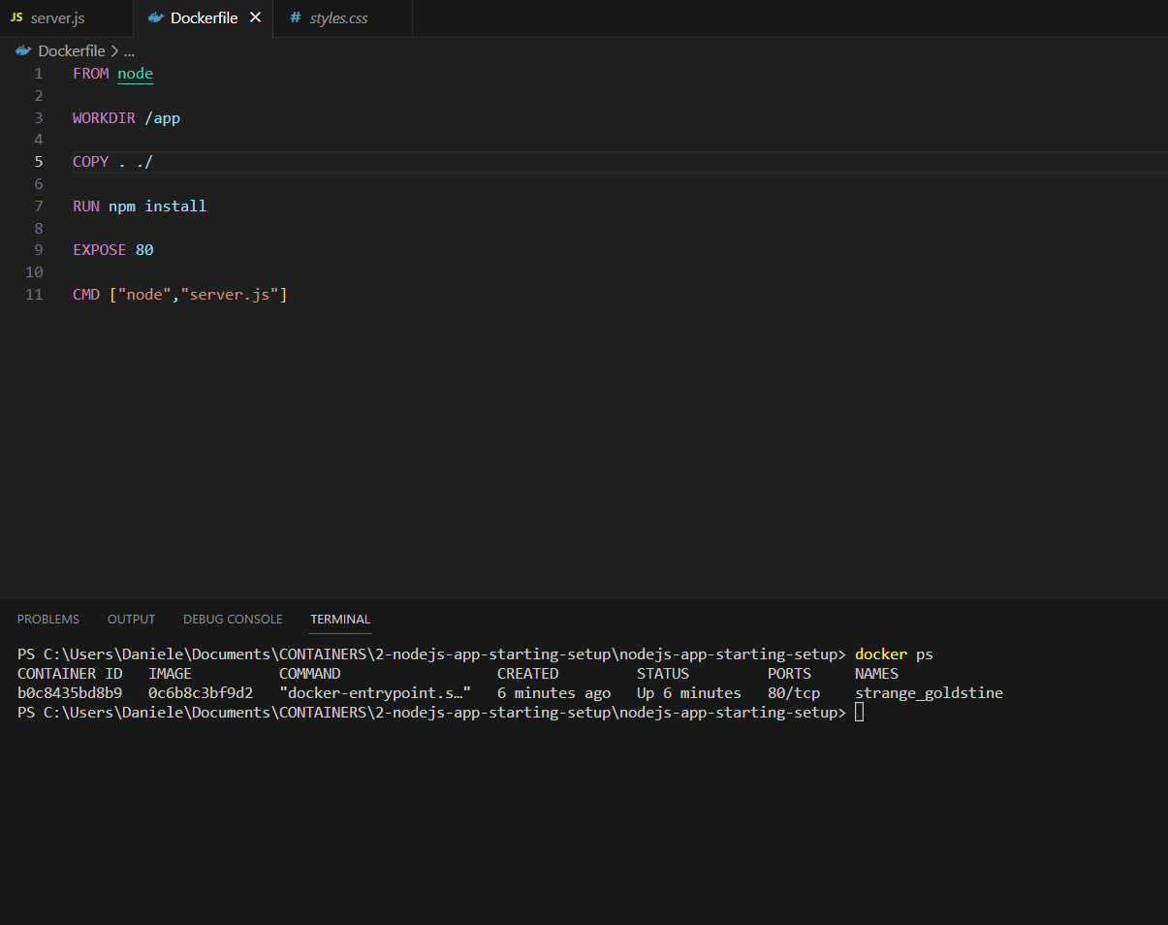
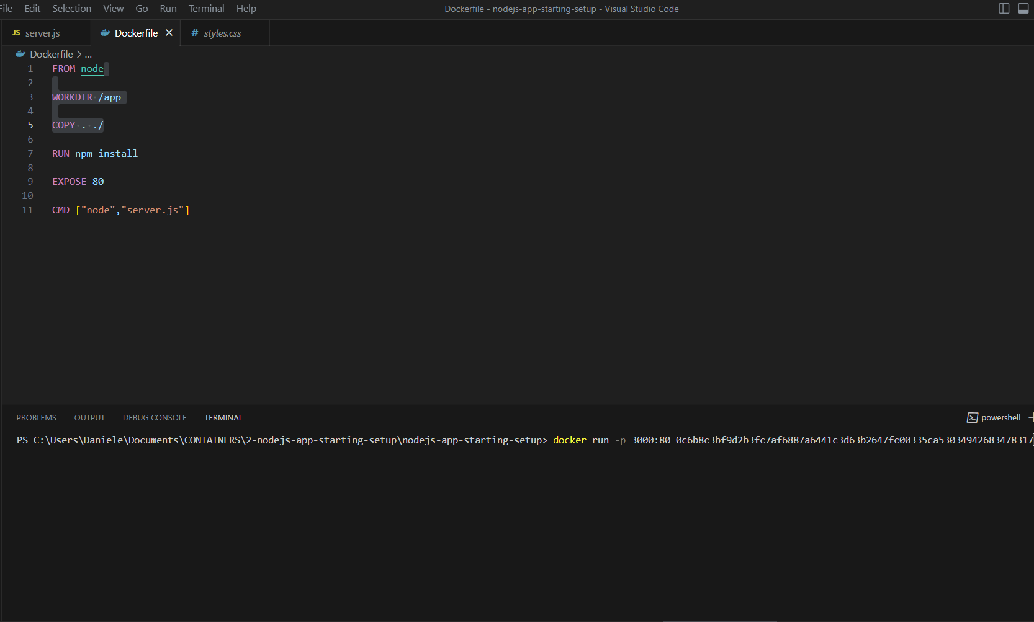
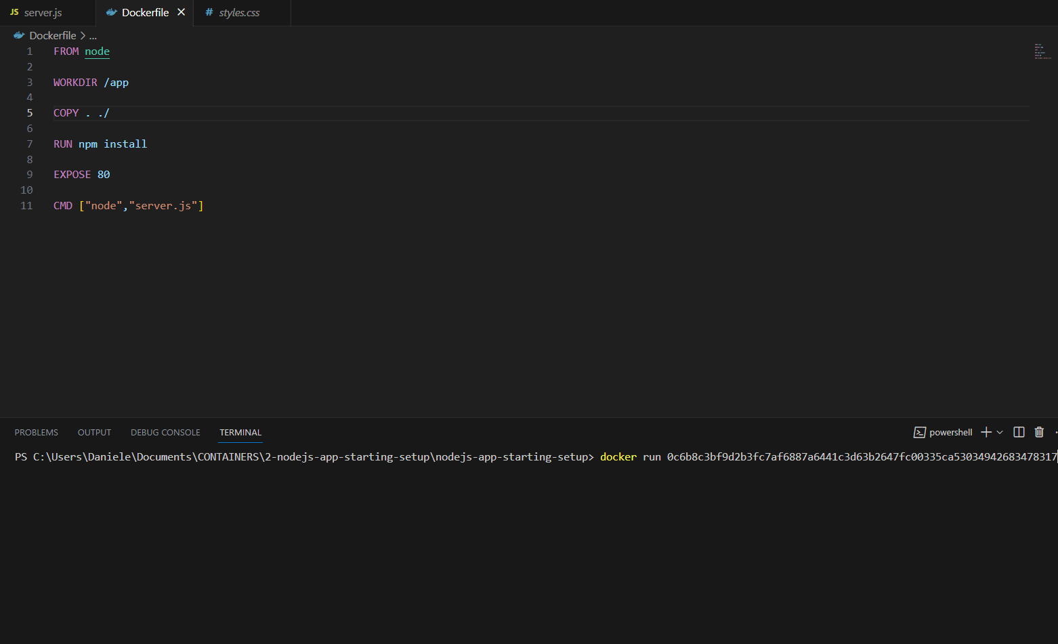
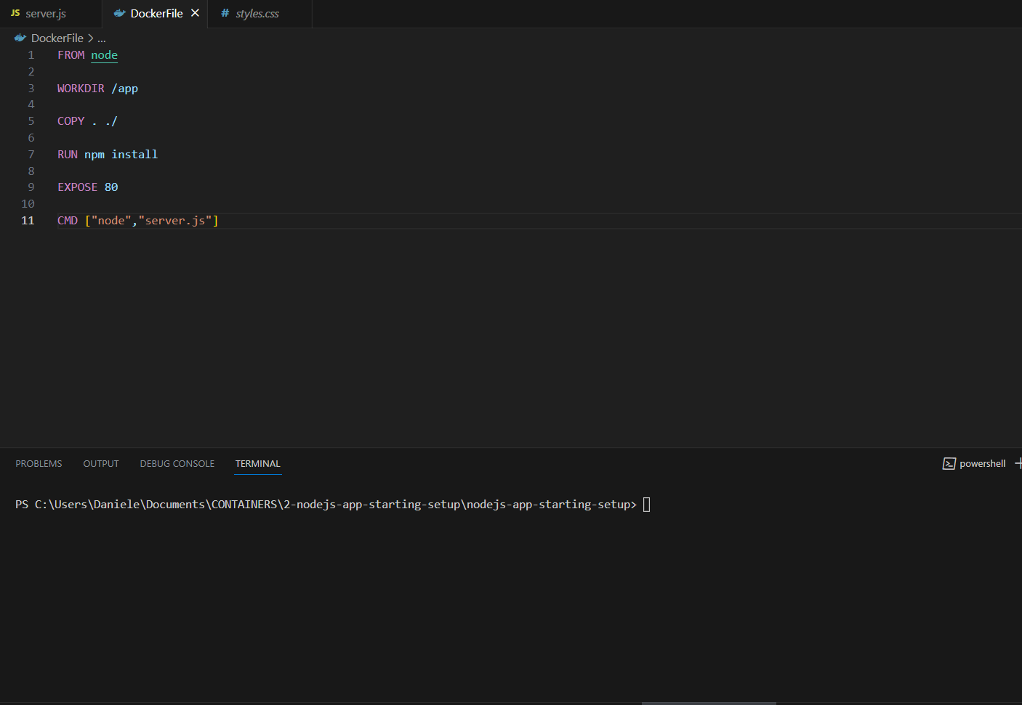
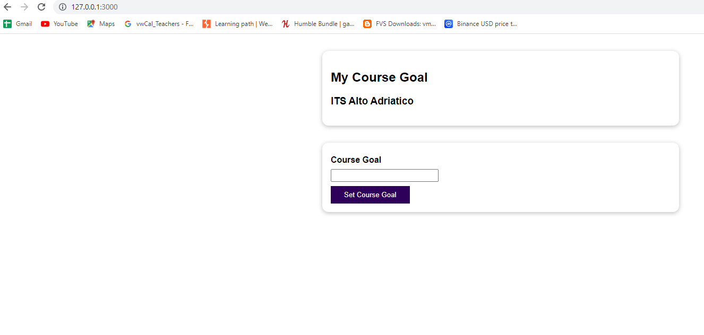
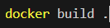
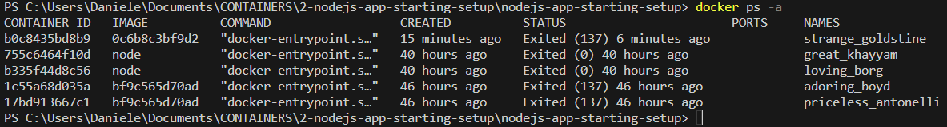
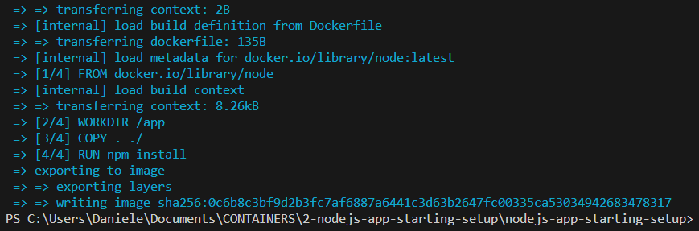
RUNNING A CONTAINER BASED ON OUR IMAGE
Please open n terminal inside your visual studio code….
this will now start this container and you will see it doesn't finish, it keeps on running.
The reason for that is that the command we executed here starts a Node server,
which is also an ongoing process that doesn't finish.
And therefore, the container also keeps on running because the command that was executed when the container is started
is a command that doesn't finish.
But you will notice that if you visit localhost,
you won't see the website, even though we exposed the port 80
So why is that not working and what can we do here? First:shutdown container…..please open a new terminal….
Why were we not able to listen
on port 80 for this custom container?
Because one step is missing here.
Yes, we have this EXPOSE 80 instruction in our Dockerfile but actually, this instruction only is added for documentation purpose
Please stop this container….
Docker ps
Docker stop “container name”
Image ID
Please copy it…..

Slide 7
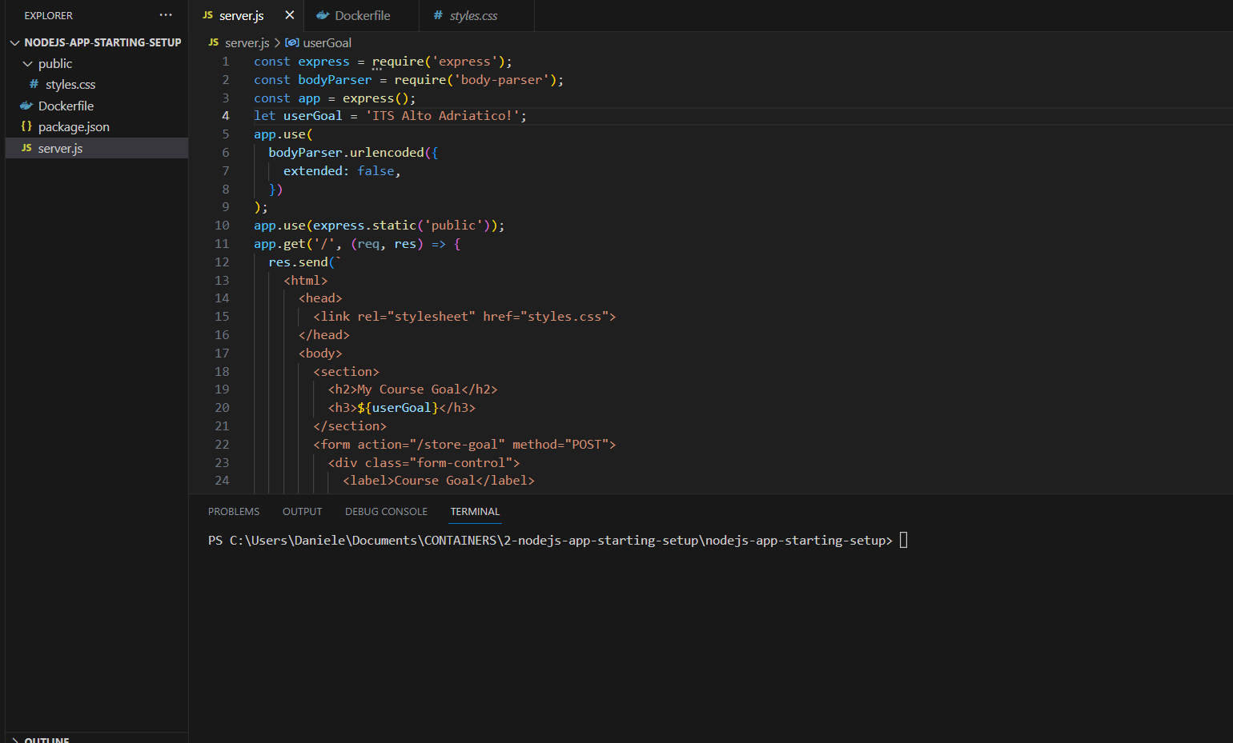
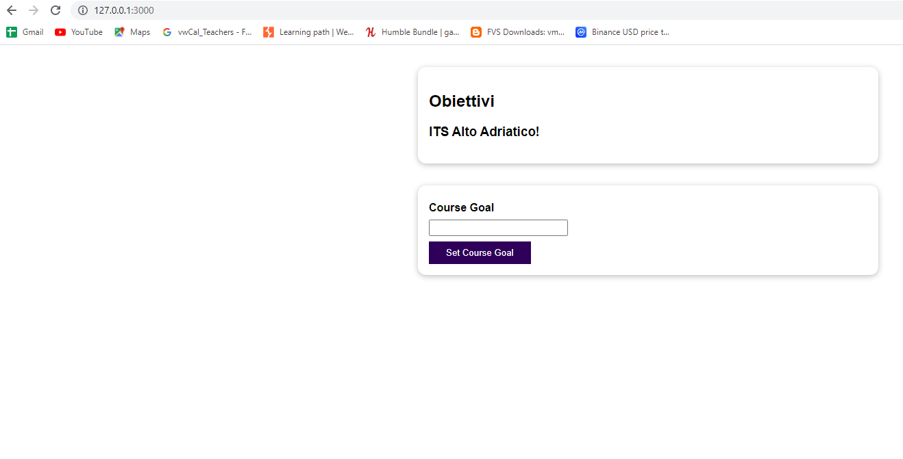
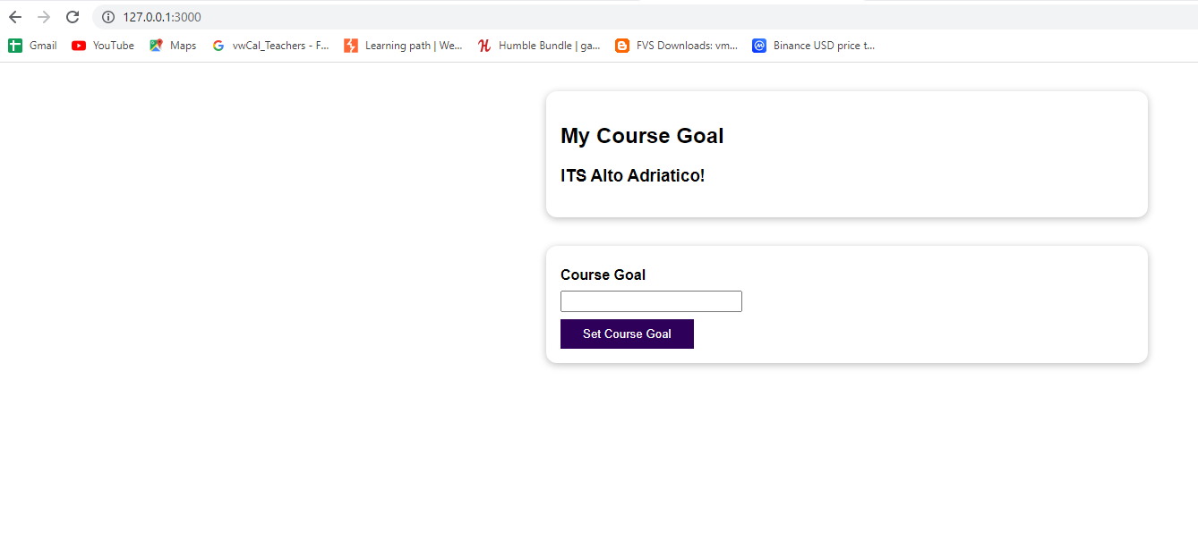
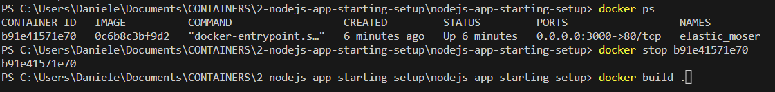
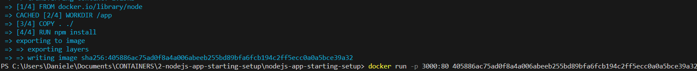
IMAGES ARE READ ONLY
Please change something inside html part of server.js file….
Nothing changed……
We need to rebuild our image to copy our updated source code into a new image.
Now, if this sounds cumbersome and strange
that we have to rebuild our image
every time we change our code,
I have a good message for you.
We will find a more elegant and faster way
of picking up changes in our code later.
Please stop container, rebuild image and rerun container and verifiy changes….
Please stop this container….
Docker ps
Docker stop “container name”

Slide 8
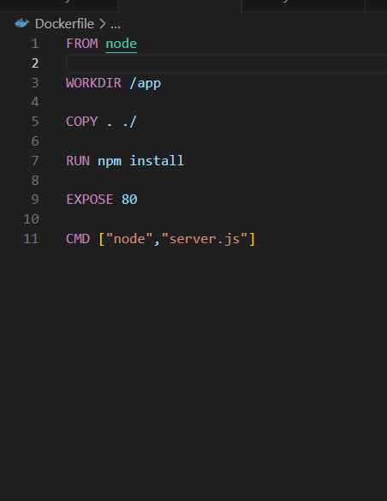
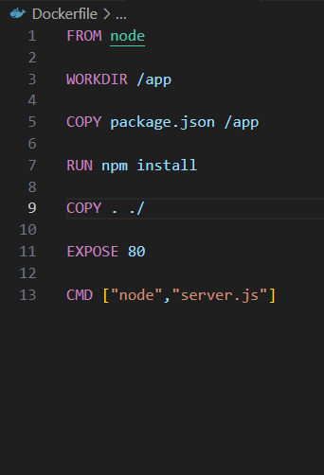
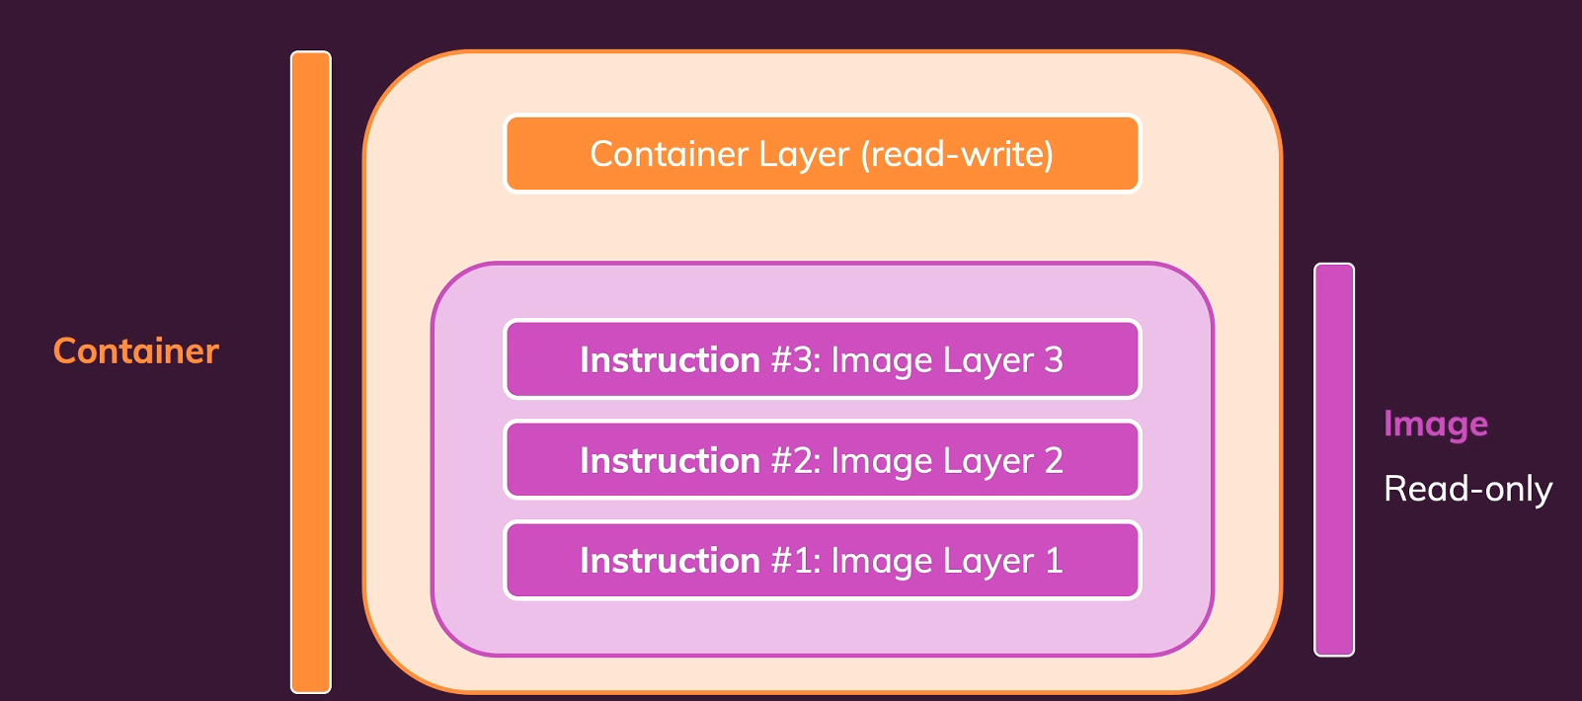
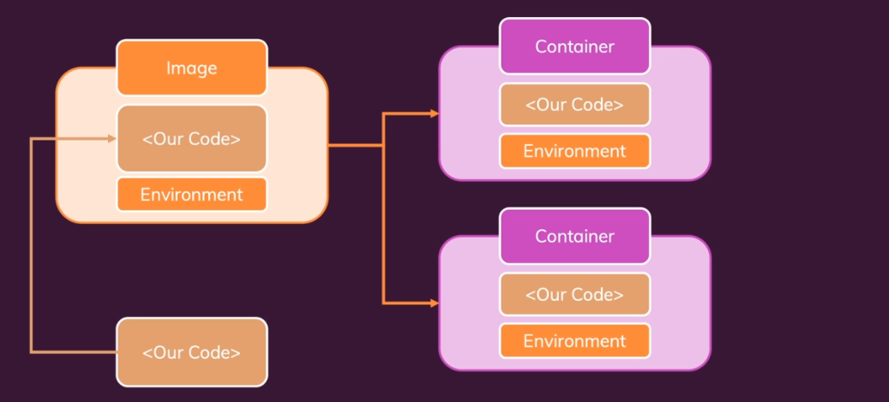
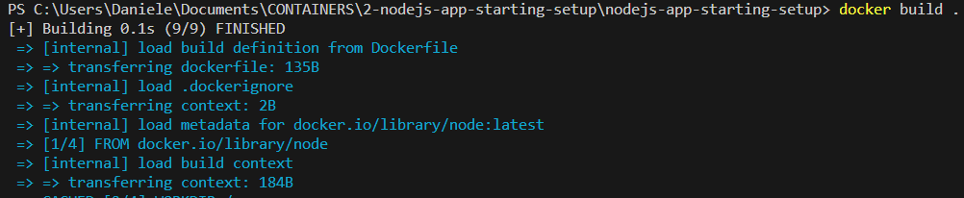
UNDERSTANDING IMAGE LAYERS
Docker caches every instruction result,
and when you then rebuild an image,
it will use these cached results, if there is no need to run an instruction again.
And this is called a layer based architecture.
Every instruction represents a layer in your Dockerfile.
And an image is simply built up from multiple layers based on these different instructions.
In addition, an image is read only
there is another important concept related to images which you also should be aware of.
They are layer based.
Now what do I mean by that?
With that, I mean that when you build an image, or when you rebuild it, only the instructions where something changed,
and all the instructions there after are re-evaluated.
Verify if you rebuil the previus image …..SUPERFAST
A container will use the environment stored in an image, and then just add this extra layer on top of it, this running node server process for example, and allocate resources, memory and so on to run the application,
but it will not copy that code.
So Our Code and the node environment,
is not getting copied three times here.
If we have one image and two containers, it exists only once in the image and containers use that image and the code in it.
So whenever one layer changed,
all subsequent layers are also re-executed.
It exists to speed up the creation of images
since Docker only rebuilds and re-executes
what needs to be re-executed?
YES OF COURSE….
OLD Docker file
NEW Docker file

Slide 9
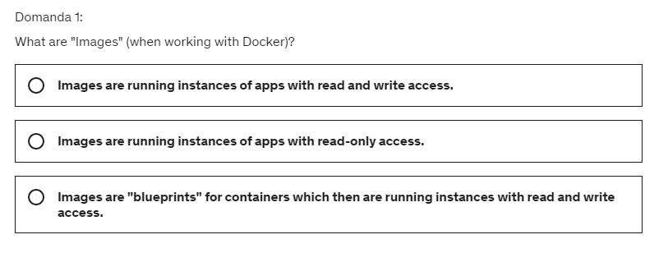
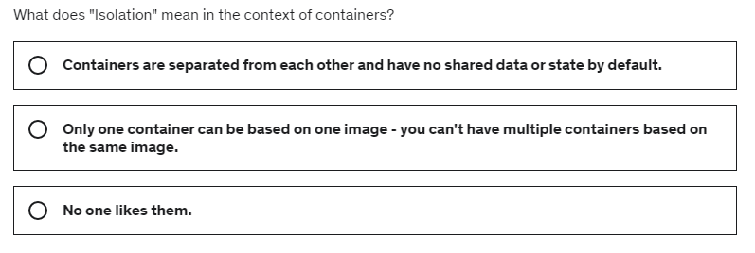
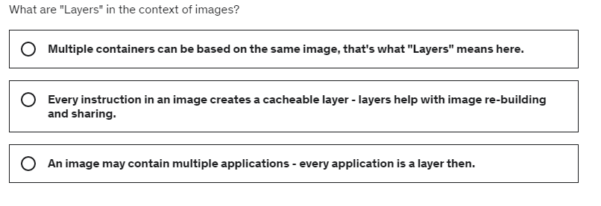
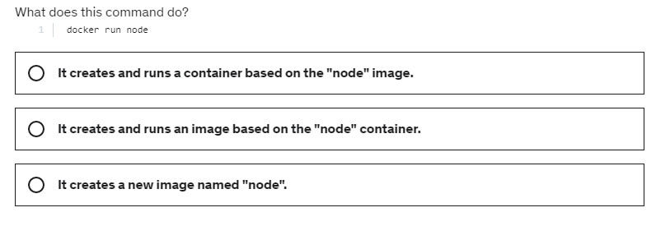
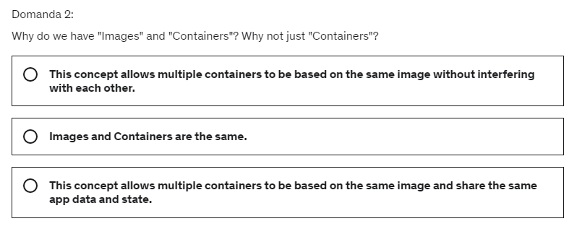
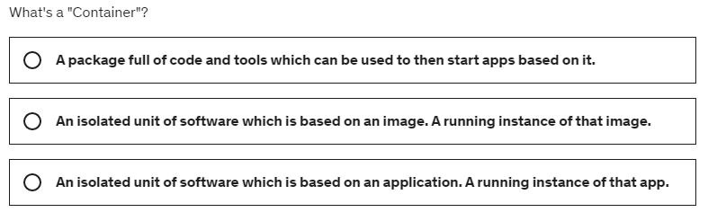
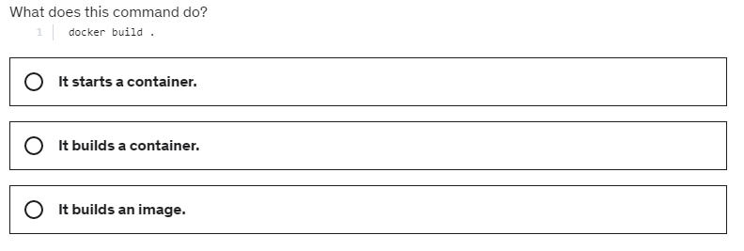
QUIZ- IMAGE & CONTAINER

Slide 10
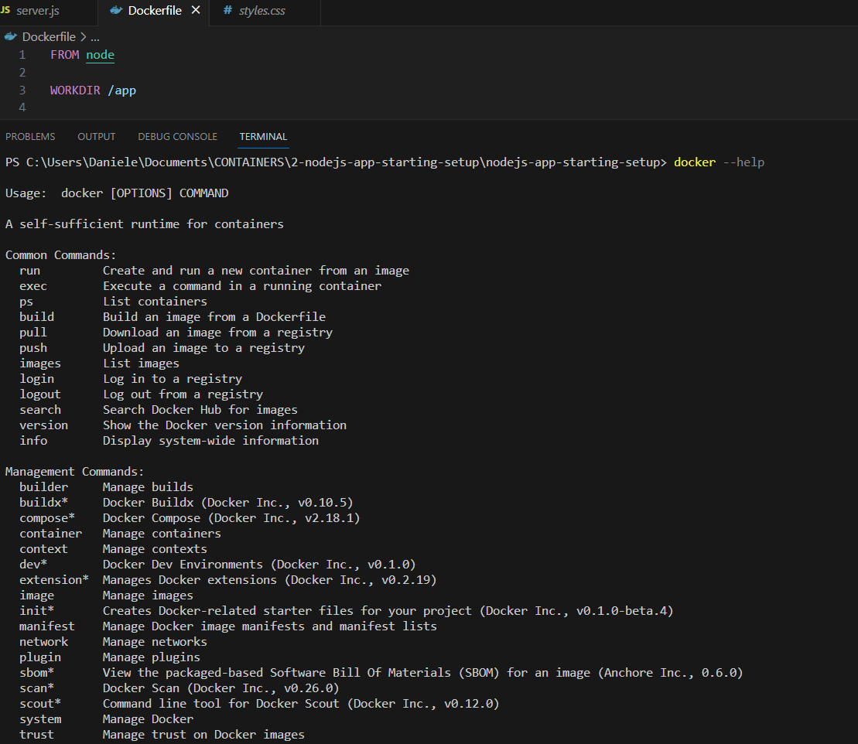
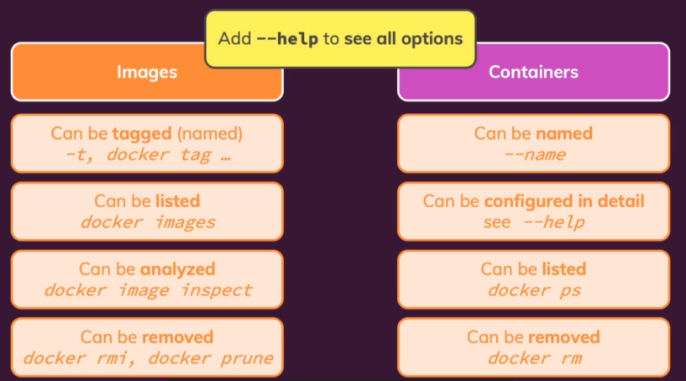
MANAGING IMAGES & CONTAINERS
How we can configure and manage our images and containers?

Slide 11
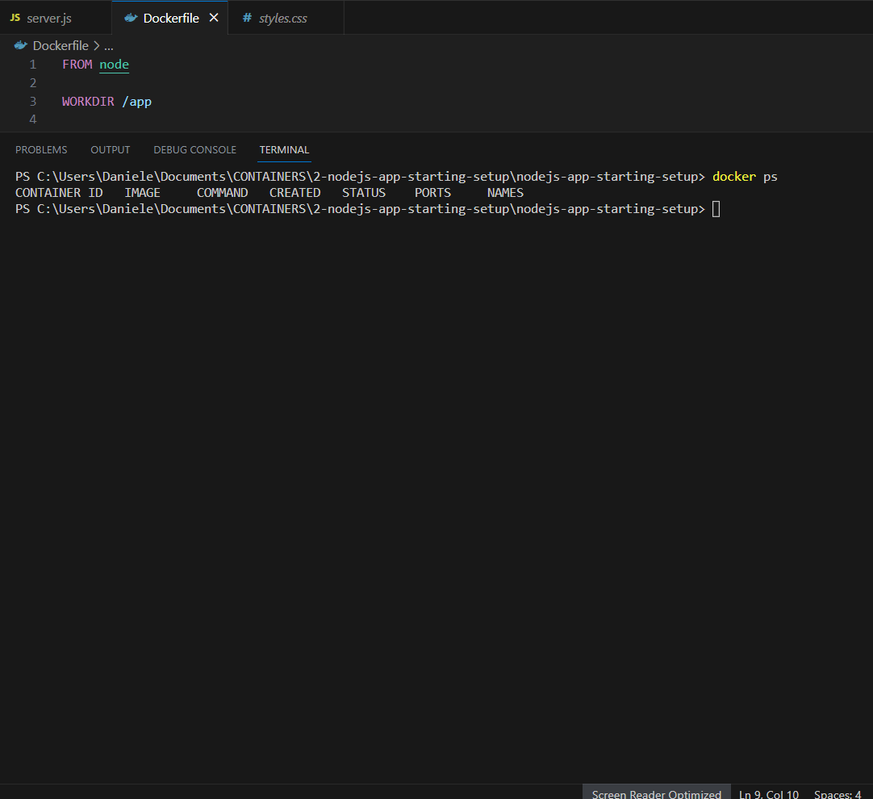



STOPPING & RESTARTING CONTAINERS
REMEMBER THAT WITH “docker run” COMMAND YOU CREATE E NEW CONTAINER…
WE CAN JUST RESTART AN EXISTING CONTAINER
And there our application is up and running, thanks to this restarted container.
This restarted container is in this strange mode :we're not really able to interact with it or to see the logs.
Instead, it started this container and then returned to the terminal
so that we could enter more commands. BUT WE CAN MAKE DIFFERENT THINGS……

Slide 12









UNDERSTANDING ATTACHED & DEATTACHED CONTAINERS
This is a DEATTACHED MODE ….
This is a ATTACHED MODE …. CONSOLE WORKING….
This is a DEATTACHED MODE …. ON CONSOLE NOTHING HAPPEN….
This is a ATTACHED MODE ….
Please stop these two containers….
Docker ps
Docker stop “container name”

Slide 13





UNDERSTANDING ATTACHED & DEATTACHED CONTAINERS
If you still want look into your running container you got two ways of doing that.
DEATTACH MODE
Please stop this container….
Docker ps
Docker stop “container name”
the automatically generated ID of the new container,you see with docker ps that we have this container up and running that still shortened ID off that up

Slide 14











ENTERING INTERACTIVE MODE
We always had a look at this demo Node.js application
which spin up that web server, and indeed web development and running web servers and other processes that deal with incoming requests , that is the main selling point of Docker.
no matter if you then use Node.js for building that web service or if you use PHP, Python, whatever it is.
But it's not just that, Docker is not restricted to that,
We have an example
A very simple Python application if you wanna call it like this
which is built for Python version three and that's important here, which does not create any web server or anything like that.
Please stop this container….
Docker ps
Docker stop “container name”
we're not attached to it
in the sense of being able to enter anything,
we can't input anything into the container
or into the application running into container

Slide 15






DELETING IMAGES & CONTAINERS
Now, one important note about removing images, you can only remove images if they're not getting used by any container anymore
and that includes stopped container.
If you have a container which is stopped,
then you can't remove images being used by that container.
You need to remove that container first.
So no matter if a container is started or stopped
images belonging to that container, can't be removed. The container needs to be removed first.
As a Containers, you can use “docker images prune”. PLEASE DON’T’ REMOVE IMAGES…
Please go back to the previous nodejs application
And it's not uncommon that you use this flag for starting your containers, especially if your container contains something like such a node server,
where you often only stop your container
if your code changed which also means that you need to rebuild your image and therefore start a new container anyways.
This container is always remove whenever we stop it
Alternatively, we can also run “docker container prune” to remove all stopped containers at once

Slide 16


INSPECTING IMAGES

Slide 17





COPYING FILES INTO & FROM A CONTAINER
Now this command can be useful for a couple of things.
It of course would allow you to add something to a container without restarting the container and rebuilding the image.
Let's say our source code changed.
Normally we need to rebuild the image because of that and restart the container.
We could of course also just copy the changed code into the container.
Typically that is not what you do though
because it's pretty error prone.
It's also not really possible to replace files
which are currently executed like the server JS file. So copying a file into a container
is not a good solution for that
We will instead learn about a better way
of updating code in a container
without rebuilding the image later
We saw how we can inspect an image.
but what if you want to look into a container
or maybe not just look into it but add something to it or extract something from it while it is already running?
Docker has a command for this and that's the CP command which stands for copy.
It allows you to copy files or folders into a running container or out of a running container.
Copying something out of a container
can also be quite interesting because if your container, for example,
would generate a bunch of log files,
you could use the Docker CP command to copy these log files out of your container onto your local host machine so that you can reach them there
This is a local project folder… this is not in the container.
NOW we want to copy into an already running container
The file test.txt inside of “Materials” folder should have been copied into inside of the container.
Okay, but how can we now see it?
PLEASE delete test.txt fileon our local host machine

Slide 18









NAMING &TAGGING CONTAINERS AND IMAGES
Please stop this container….
Docker ps
Docker stop “container name”
NOTE: if you want to remove ALL images, incl tagged images, you need to run:
“docker image prune –a”
Similar concepts exist for images…..

Slide 19
TIME to PRACTICE: IMAGES & CONTAINER
Dockerize BOTH apps - the Python and the Node app.
Create appropriate images for both apps (two separate images!).HINT: Have a brief look at the app code to configure your images correctly!
Launch a container for each created image, making sure, that the app inside the container works correctly and is usable
Re-create both containers and assign names to both containers. Use these names to stop and restart both containers.
Clean up (remove) all stopped (and running) containers, clean up all created images.
Re-build the images - this time with names and tags assigned to them.
Run new containers based on the re-built images, ensuring that the containers are removed automatically when stopped.

Slide 20



SHARING IMAGES-OVERVIEW
Docker would allow us to have multiple projects on our computer with different dependencies and different versions, and they could co-exist side by side without us having to uninstall or re-install various tools all the time.
We could have a Python 3.7 based app
next to a Python 3.9 based app without switching python versions in between.
This is not the only reason
We're also using it to share our images and containers with others.
That could be team members who are working on the same project, or that could be servers on which we wanna deploy our containers.
I want start with sharing images and containers with other persons, or even with ourselves on different machines

Slide 21













PUSHING IMAGE TO DOCKERHUB
Now, how can we share the finished, the built images?
Docker has built-in commands for sharing images
because this is a key mechanism of Docker.
Hence it's very convenient to do that.
And when we wanna share images, there are two main places where we can push our images to:
Docker Hub
private registry of your choice
Docker Hub is simply the official Docker image registry but there thousands of other services out there, which also know how to handle incoming images and which can be used to store and distribute images.
FREE TO USE
But if we already got the image, which we wanna use, we can also reuse that because Docker has a command, which we can use for renaming, for retagging images.
docker tag imagename:tagname dgobbo/applicazioni:tagname
REMEMBER: thic command create a copy of original image
It does not upload my entire image,
which is pretty big.
the node image is already on Docker Hub,
so it establishes a connection to that node image and only pushes the extra code it needs,
only the extra information and not the entire node image again
THIS SAVE SOME SPACE ON DOCKER HUB AND SAVE SOME BANDWIDTH
Please open visual studio code and open “nodejs-app-starting-setup”

Slide 22




PULLING & USING SHARED IMAGES

Slide 23




QUIZ TIME

